Slide 1
SCAR NDA Demo
Storyboard
The world of medical imaging on your desktop.
V 1.1
May 7, 2004
CONFIDENTIAL

Slide 2
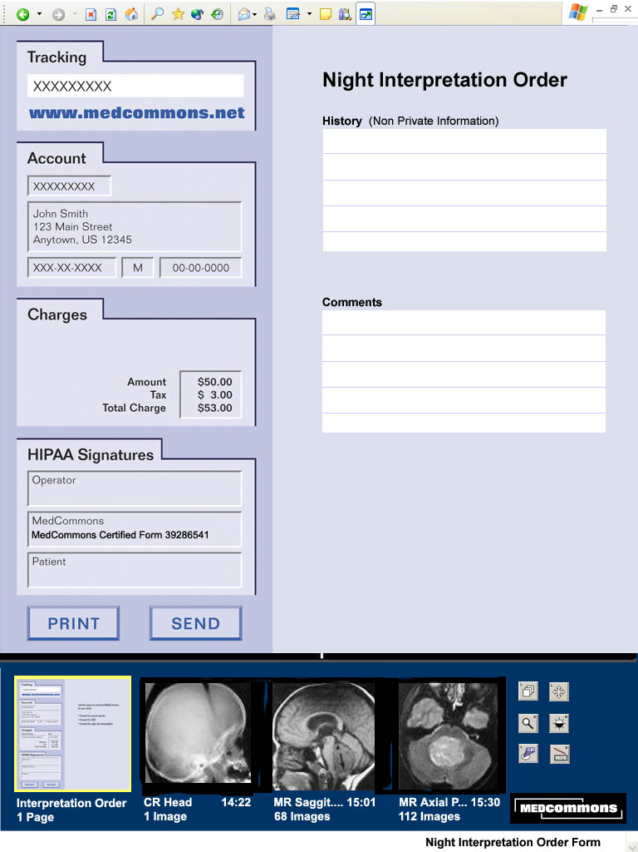
New Night Order
View Frame
Control Frame
Notes:
State 1: IE browser in Full Screen mode after the user (a technologist or ER doc) has selected a specific study and looked it over for quality control purposes.
Gesture - Select Night Interpretation Order Form from the Menu (at bottom of screen below Control Frame) The title of the Order (Night Interpretation Order) confirms this choice.
Tracking Number – Random, Assigned by MedCommons, reveals no PHI
Account shows the Patient’s Name and other demographic info – same info as upper left hand corner of image overlay.
Charges – Night Interpretations are billed by the institution so no credit card info is required.
HIPAA Signatures – Initially, only MedCommons has signed this form to indicate that this is a Certified recipe.
User Prompts – History – This is the information that the night call radiology administrator might use to decide which radiologist might do the interpretation. This information will be visible to people who will not be entered into any HIPAA log. They do not need to see the Account Name or any Comments that the ER doc wants to share with the radiologist.

Slide 3
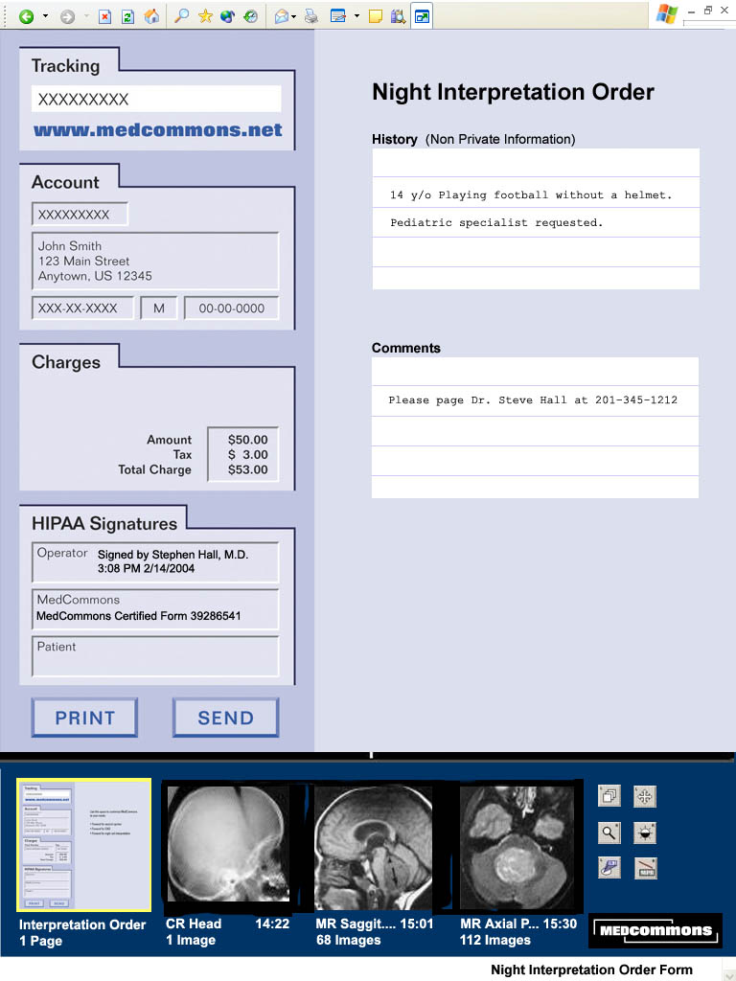
Finalized Order Form
Notes:
State 2 – The user has finished interacting with the form
Gesture – User clicks in the Operator section of the HIPAA Signature block.
Operator Signature - A Modal Dialog Window opens. It is titled:
Signature of Stephen Hall M.D.
Password: ---------- (the password is obscured as it is entered)
Sign button and Cancel buttons
Gesture – Operator clicks Sign button

Slide 4
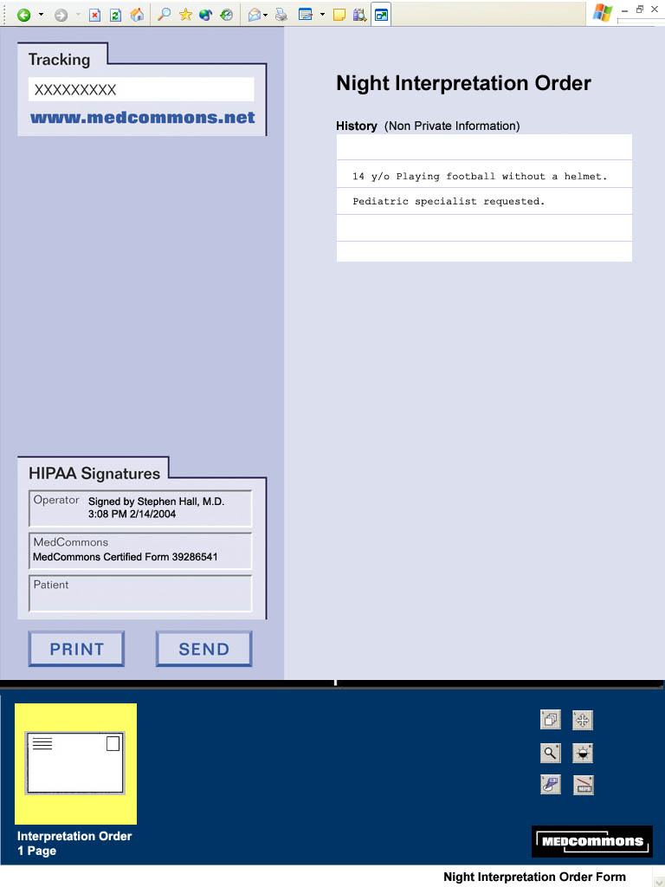
Closed Order Form
Notes:
State 3 – The user has signed the Order all PHI is now obscured.
Gesture – click Send button
An email to some radiologist is generated that includes a hyperlink to WADO Viewer in State 4

Slide 5
Email to Night Radiologist
Dear Radiologist:
Please interpret this study:
http://www.medcommons.net/wado?tracking=7345097234
History: 14 y/o Playing football without a helmet. Pediatric specialist requested.
Signed: Stephen Hall, MD.
For more information about MedCommons please see www.medcommons.net or call 800-234-5545
Notes:
State 4 – An email shows up – the New Mail alert is visible in the Windows Task Bar.
Gesture – Select the email app.
Point out that the Night Interpretation Recipe includes transfer of the History and the Operator Signature to the email.
Gesture – The radiologist clicks the MedCommons WADO link.

Slide 6

MedCommons WADO Invitation
Notes:
State 5 – A potential – but not yet authorized - user has clicked on a hyperlink or entered a Tracking Number on the MedCommons page.
Gesture – Click the Open button or the Order Thumbnail
Authorization - A Modal Dialog Signature Window appears and alerts the user that they are about to sign the MedCommons HIPAA log with their name as collected from their Windows XP login.

Slide 7
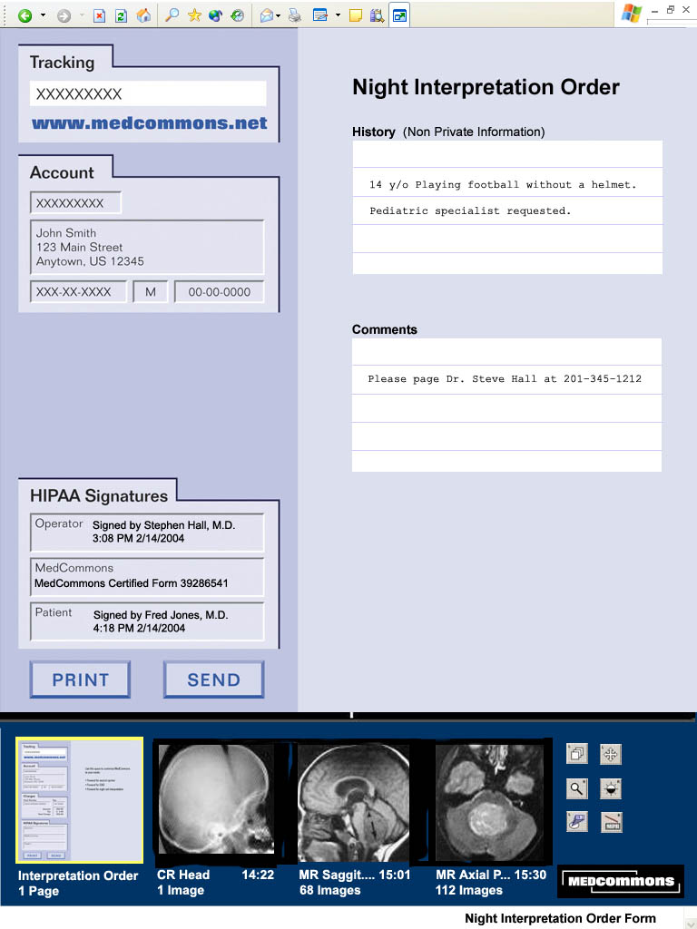
Open Order
Notes:
State 6 – The night radiologist has been authorized to open the Order. Notice that a third signature is visible in the HIPAA Signatures block.
Gesture – Click on a thumbnail to view one of the three series on display or select another series from the menu.
Note – We need a way to indicate the total number of Series to the user because they may not know to click on the menu. A big triangle labeled More Series – 7 Total could be displayed to the right of the last thumbnail.

Slide 8
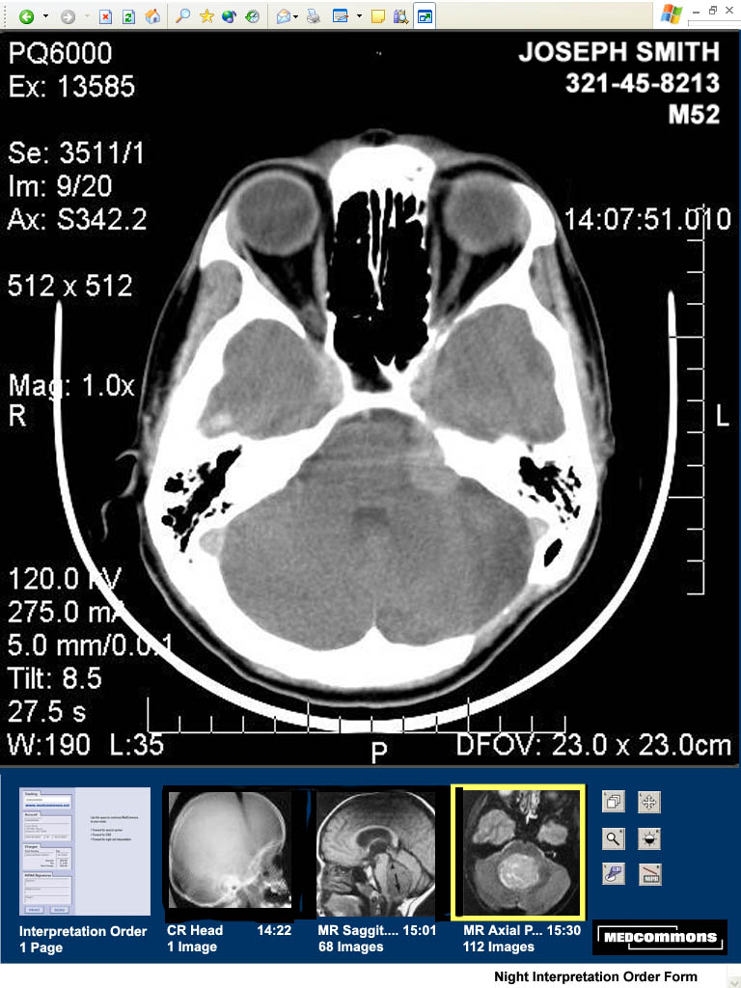
View Study
Notes:
State 7 – The user has clicked on an image thumbnail.

Slide 9
View HIPAA Log
A table of operator’s HIPAA Log entries sorted by time and showing at least…
Date and Time
Tracking Number
The contents of the HIPAA Signatures Block
….
Notes:
State 8 – The User has selected View HIPAA Log on the Menu at the bottom of the screen.
Gesture – Clicking Back or Close this Window returns the user to the WADO Viewer.

Slide 10
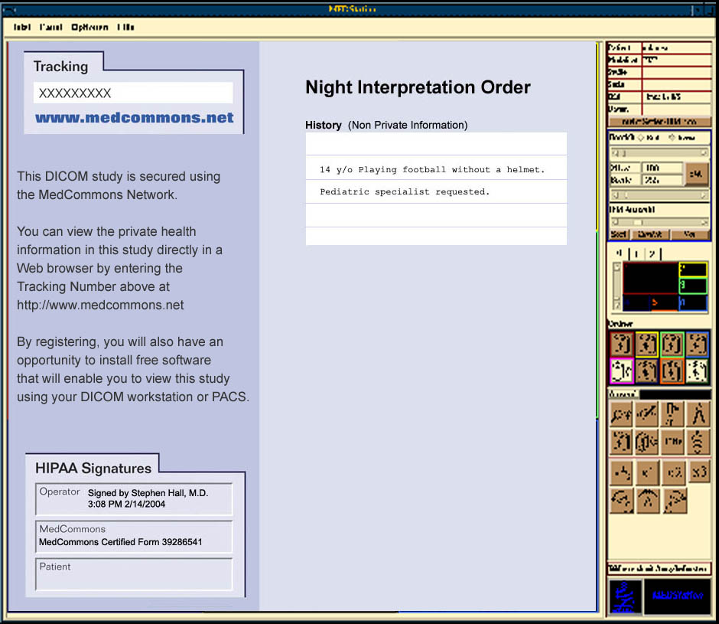
DICOM Invitation

